Slide 1
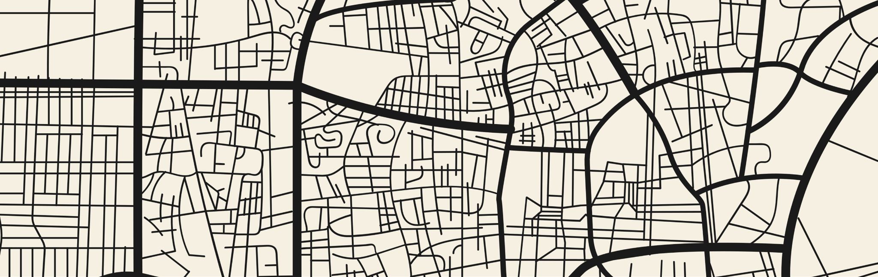

The Impact of Urban Environment on Microclimate: A SegFormer-Based Study
Presenters: Erik Pinhasov Nave Cohen

Slide 2
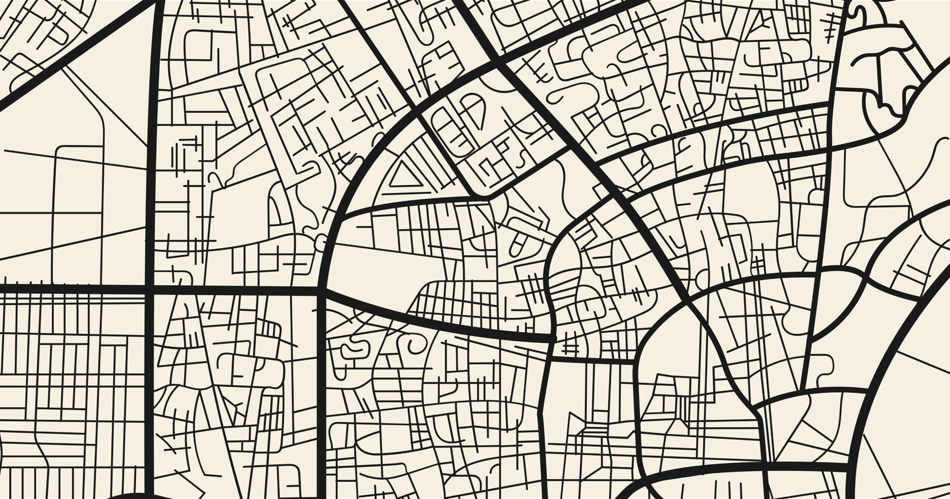
The Growing Importance of Urban Microclimates
Urbanization: By 2050, 68% of the global population will live in cities, intensifying local climate challenges.
Microclimates: Urban microclimates, like the Urban Heat Island (UHI), increases temperatures in cities.
Challenges: Traditional climate models fail to capture these local temperature variations, making it difficult for planners to respond to climate risks.

Slide 3
The Urban Heat Island Effect
An urban heat island occurs when a city experiences much warmer temperatures than nearby rural areas.
Factors:
Reduced natural landscapes in urban areas
Urban material properties
Urban geometry
Heat generated from human activities
Weather and geography

Slide 4
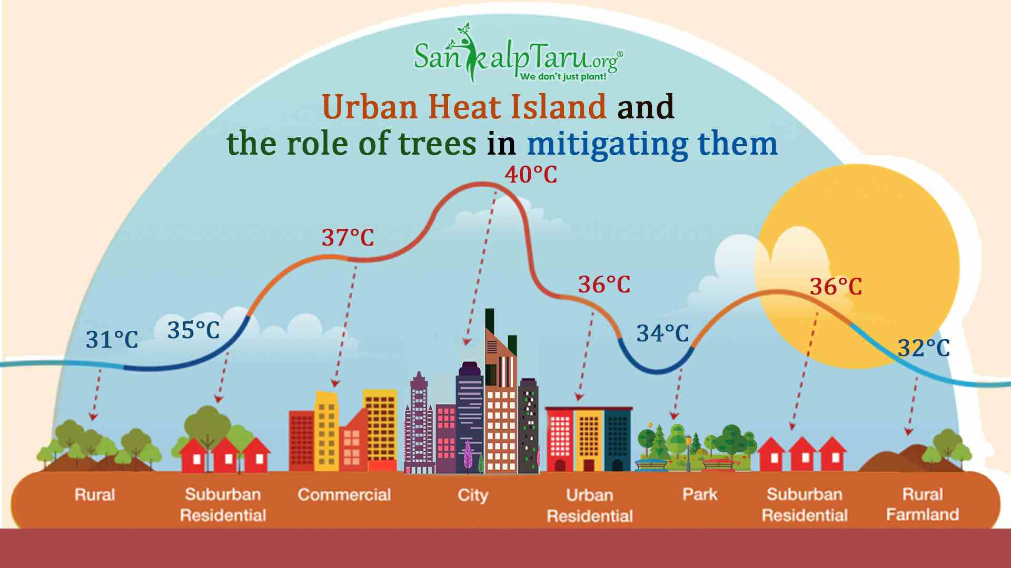
The Urban Heat Island Effect

Slide 5



Consequences of The Urban Heat Island
Increased energy and water consumption
Health risks and higher air pollution
Impact on Ecosystems

Slide 6
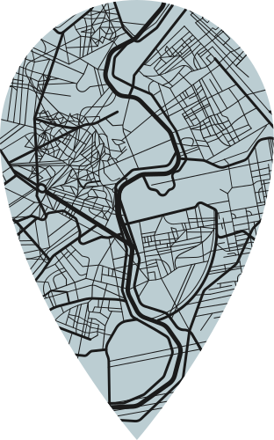
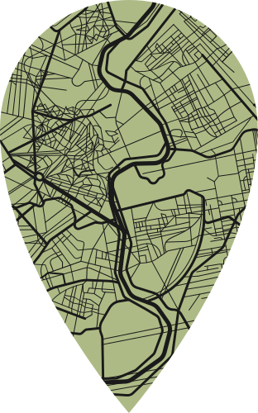
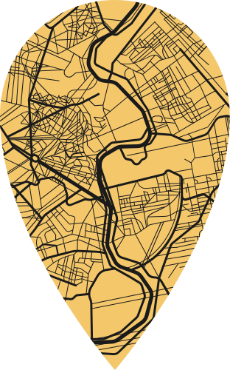
Current Approaches: Traditional Climate Models
Models like the Weather Research and Forecasting model are used for large-scale weather and climate predictions. They simulate regional or global climate phenomena by integrating atmospheric data over wide areas.
Problems:
Inflexibility for urban scenarios
Computationally intensive
Limited Local Precision

Slide 7
Current Approaches: Meteorological Networks
Ground-based weather stations that collect data such as temperature, humidity, and wind speed at specific locations. Provides accurate real-time data for localized climate monitoring.
Problems:
Limited spatial coverage
Expensive and logistically difficult
No data on urban structures

Slide 8
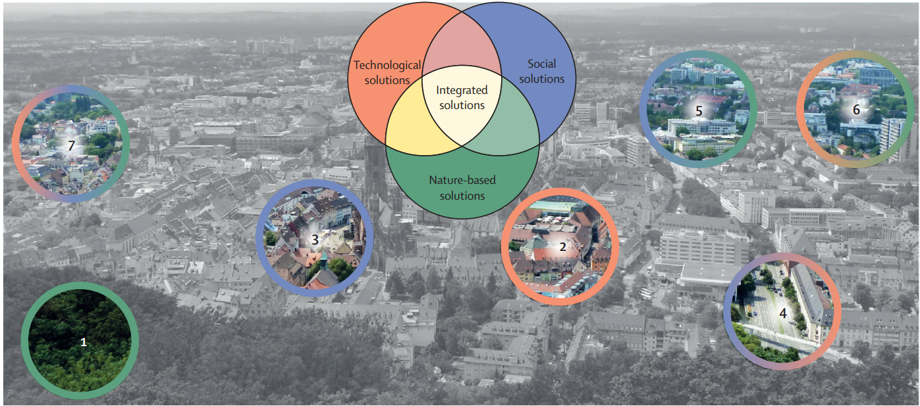
From Problems to Solutions
After recognizing the gaps, we developed a solution for precise urban microclimate insights.
Step 1: Identifying the Core Needs
Understanding urban climate complexity
Recognizing data gaps for precise analysis

Slide 9
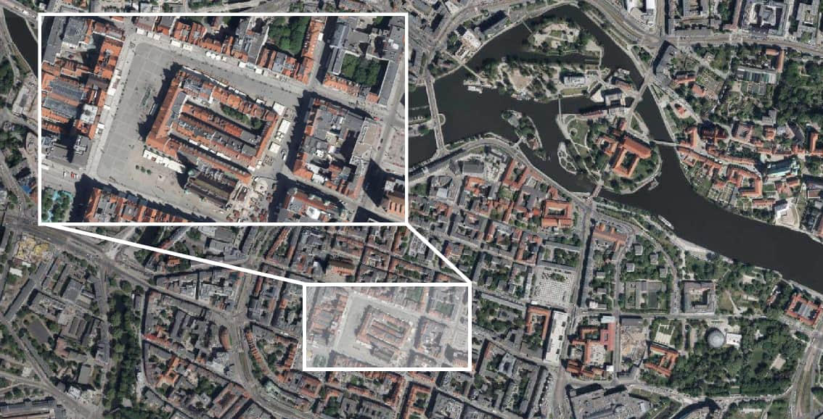
From Problems to Solutions
After recognizing the gaps, we developed a solution for precise urban microclimate insights.
Step 2: Leveraging High-Quality Data
The Power of Imagery
High-Resolution for Fine Details

Slide 10
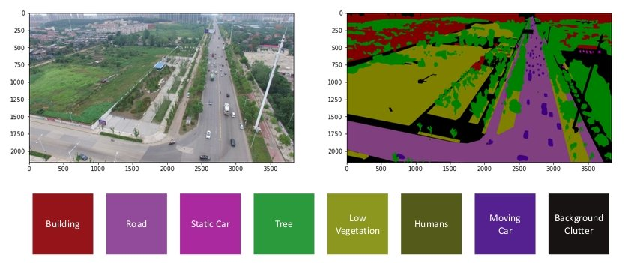
From Problems to Solutions
After recognizing the gaps, we developed a solution for precise urban microclimate insights.
Step 3: Integrating Machine Learning
Unlocking the Potential of Data
Extracting Valuable Patterns from Data

Slide 11
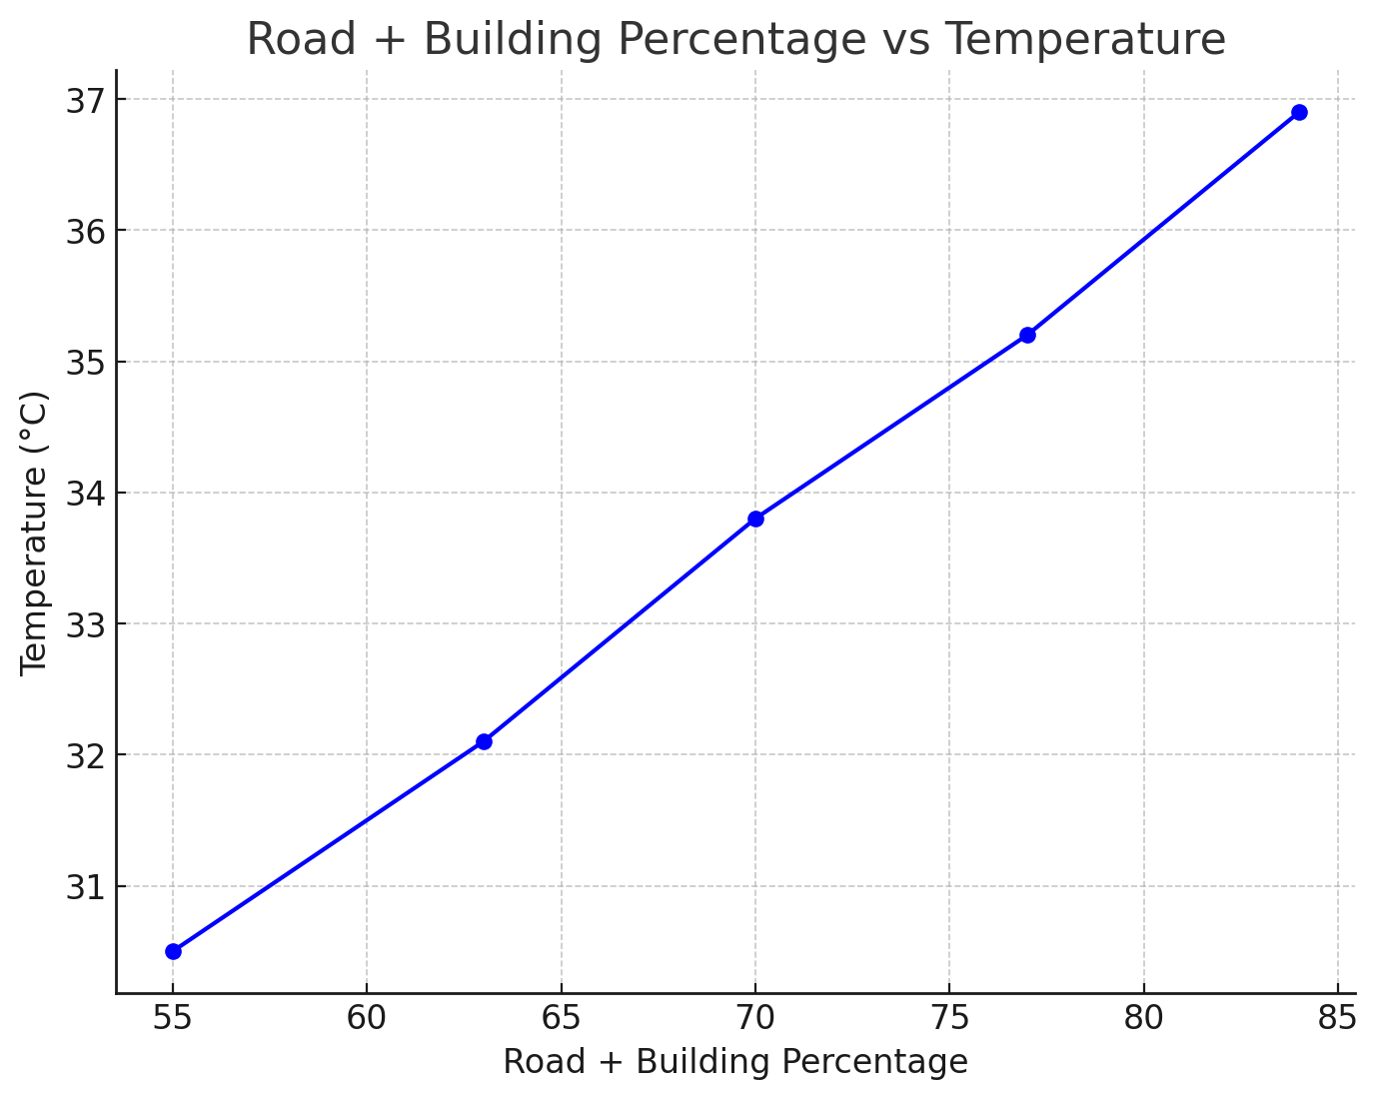
Microclimate Prediction System
Main Objective
Develop a system for predicting and research for correlation between urban environment changes to temperatures using satellite imagery segmentation and temperature data over the years.

Slide 12
Methodology Overview
Model Development
We will created a SegFormer-based segmentation model to classify land-cover in urban areas (buildings, woods, water, roads, etc.).
Data Collection
Gather satellite imagery from 2005 to 2024 for the chosen urban location.
Collect corresponding temperature data for the same period.
Model Application
Apply our fine-tuned SegFormer model to calculate the percentage of land cover types (buildings, woods, etc.) in each image.
Dataset Creation
Compile the results into a dataset to analyze land-use changes and discover correlations with temperature variations over time.

Slide 13
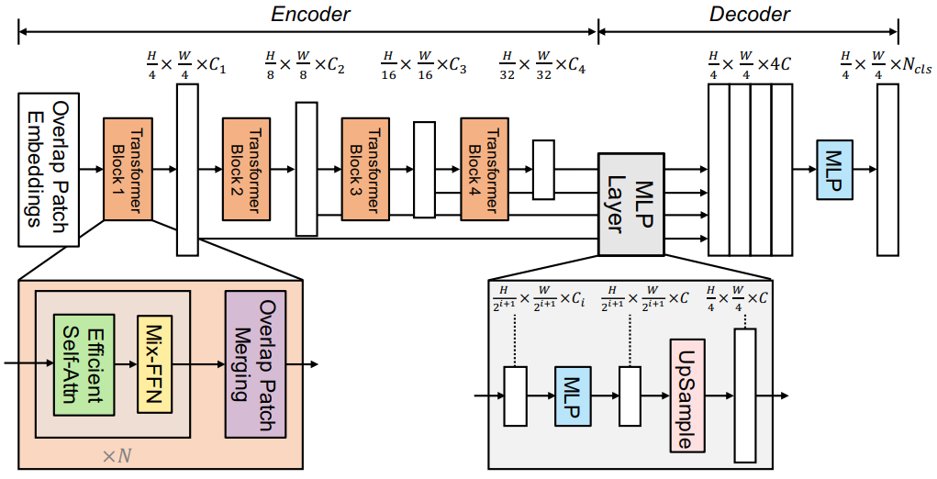
SegFormer Overview
Hierarchical Transformer Architecture SegFormer uses a transformer-based encoder instead of traditional convolution layers, allowing it to capture both local details and global context.
Input Processing The encoder divides images into patches, applying self-attention to dynamically model relationships between pixels, making it ideal for semantic segmentation.
Efficiency & Scalability Unlike many models, SegFormer doesn't need position embeddings, making it adaptable to various input sizes while maintaining high accuracy and efficiency in both memory and speed.
MLP Decoder Multi-level features from the encoder are fused using an MLP-based decoder, producing precise segmentation maps without needing complex post-processing steps.
Versatile Use With a streamlined architecture, SegFormer is effective for real-time and large-scale segmentation tasks, balancing performance and resource efficiency.

Slide 14
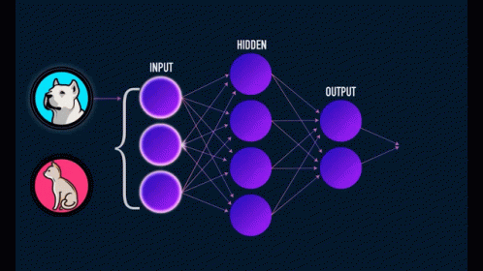
Model and Algorithm Details
Pseudo-code Overview
Initialize SegFormer model (HyperParameters).
Train the model against image and analyze predictions according to ground truth images.
Make augmentation (Random cropping, rotation, noise simulation) on the dataset during training using the dataloader pipeline for robustness and better training.
Create metric for model evaluation during training.
Test model predictions against test dataset, with the according metrics.

Slide 15
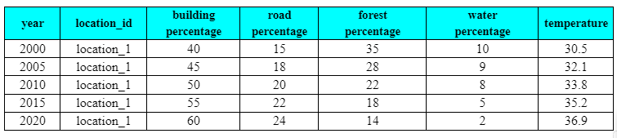
Dataset Overview
Dataset Structure
Yearly Data: Collected for 2000, 2005, 2010, 2015, 2020.
Location-based: Focused on specific urban areas (location_1).
Buildings: % of land occupied by buildings.
Roads: % of land used for roads.
Forests: % of green space.
Water: % of water bodies.
Data example:

Slide 16
Verifications/Use Cases
Step | Verification/Use Case | Expected Outcome
1 | Dataset successfully loaded and preprocessed | Datasets are preprocessed and patched as explained in the formulas, number of patches equivalent to formulas outcome, all images have equivalent masks
2 | Model initialization and forward pass test: Verify the model initializes properly and performs a forward pass with mock input. | Model is initialized without errors. Model forward pass produces output with the expected shape (batch_size, num_classes, height, width) based on mock image input.
3 | Loss function test: Check that the model computes the loss correctly given the input and ground truth mask. | The model's computed loss (e.g., CrossEntropyLoss) is greater than zero and valid. No errors or crashes during computation.
4 | Prediction output test: Ensure that the model generates valid segmentation predictions (classes) from the forward pass. | The predictions are of the correct shape and contain valid class indices (e.g., between 0 and num_classes - 1).
5 | Edge case handling test: Test how the model handles edge cases such as large inputs or invalid inputs (e.g., incorrect dimensions). | The model handles edge cases appropriately: for large images, it produces correct output; for invalid input (wrong dimensions), it raises appropriate errors.
6 | Training step test: Simulate a single training step including a forward pass, loss computation, backpropagation, and optimizer step. | The model completes a training step successfully, with loss decreasing and the optimizer updating the model's parameters without errors.
7 | Early stopping functionality test: Test that the early stopping mechanism halts training when the validation loss stops improving | Early stopping is triggered correctly after X epochs without validation loss improvement.

Slide 17
Expected Challenges
The lack of an appropriate dataset poses a significant challenge for achieving accurate and consistent segmentation results.
Dataset Variability: Inconsistent quality and resolution across different years of the same area could affect the precision of segmentation.
Model Generalization: Ensuring good generalization performance for both urban and rural areas at different periods of time may be difficult.
Computational Resources: Large-scale satellite datasets for training may require significant GPU or cloud resources, which are not always available.
Dataset Integration: Merging multiple datasets with different formats and resolutions can complicate data management and training. In addition, using different datasets with varying class definitions could result in segmentations that are inconsistent.
Temperature Data Alignment: Aligning satellite images with accurate temperature data may be challenging and affect correlation results.
Segmentation Performance: Achieving high-detail segmentation for all urban features without missing smaller objects can be difficult.
Correlation Interpretation: Drawing actionable insights from the correlation between urban changes and temperature may be complex.

Slide 18

Detailed Urban Analysis
In-depth segmentation of urban features such as buildings, roads, and green spaces.
Localized Climate Predictions
Innovation
Predict temperature variations specific to different urban structures.
Insightful Historical Comparisons
Analyze changes in urban features over time and their impact on local temperatures.

Slide 19
Unique Multi-Year Dataset
Captures how urban development correlates with temperature changes over time.
Contribution
Data-Driven Planning
Reveals clear links between infrastructure shifts and temperature, aiding climate-resilient decisions.
Targeted Climate Insights
Shows how building density and green space reduction directly affect temperature, guiding sustainable growth.

Slide 20
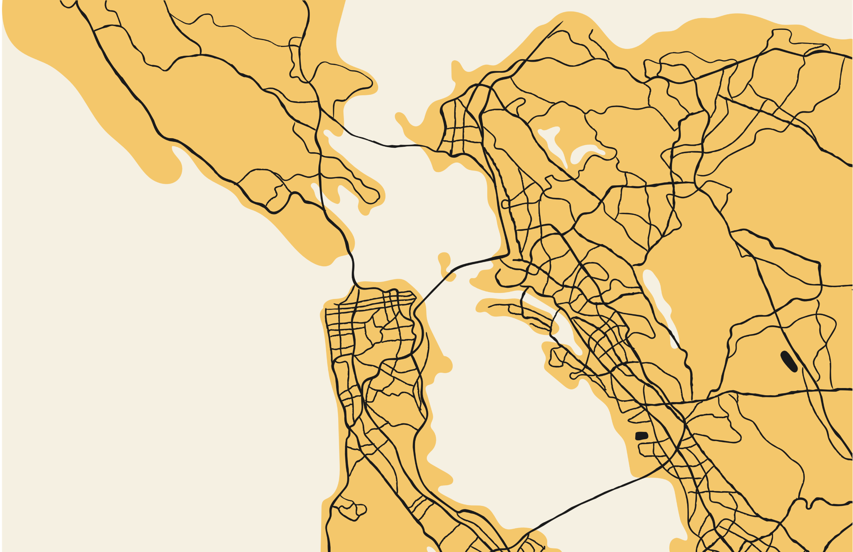
Thank You!
“Cities are on the front lines of the climate crisis. How we build and rebuild them will define our future”
— Eric Garcetti

